Slide 1
Common Hazards in the
Food & Beverage Manufacturing Industry
Notes:
Trainer Notes:
Use this slides as a general introduction to common hazards in food manufacturing sector. Insert additional hazards (which may not be covered here) as necessary.
Supplement the common hazards (e.g., slip, trip and fall, cut by objects, contact with hot objects/surfaces) with incidents actually encountered at your workplace.
The recommendations (non-exhaustive) in the case studies, if adhered to, can help to prevent accident recurrence.
You are encouraged to insert your company’s own case study examples (if any) which your staff can better relate to.
This will help enhance the effectiveness of your WSH training session.

Slide 2
This set of slides may be used to complement your company’s in-house Workplace Safety & Health (WSH) training for workers.
Common hazards highlighted can be contextualised to meet your workplace needs. Case studies with recommendations serve as good learning points. Safe work practices can help to prevent workplace accidents and injuries.
All rights reserved, May 2019. The information provided in this training slides is accurate at time of publication. All examples shared in this training slides are meant for learning purposes only. The learning points for each example are not exhaustive and should not be taken to encapsulate all the responsibilities and obligations of the user of this training slides under the law. The Workplace Safety and Health Council does not accept any liability or responsibility for any modifications made to this set of training slides.
Notes:
Trainer Notes:
The contents outline provide a preview of the topics that will be covered in this presentation.
You may wish to highlight the WSH Policy and Rules and Regulations at your workplace and the need for workers to work closely with WSH personnel (e.g., WSH Officer, WSH Coordinator) and management.
In this presentation, you may choose to focus on the hazards commonly found at your workplace. Share as many real-life WSH applications with workers.
Please also use these presentation slides as a guide to ensure that all hazards are adequately addressed in your company’s Risk Management programme.

Slide 3
Contents
Workplace Safety and Health (WSH) Policy
WSH Rules and Regulations
Risk Assessment
Communication of WSH Hazards
Common Hazards
Other Hazards

Slide 4
1. Workplace Safety & Health (WSH) Policy
The objective of the WSH Policy is to show the management’s commitment in ensuring a safe and healthy environment for everyone, and this includes all employees, visitors, interns, vendors, contractors, etc at the workplace.
Example of a WSH Policy Statement (Source: www.wshc.sg)
The WSH Council is committed to ensuring the safety and health of its members and employees. We believe that all WSH incidents are preventable. We will continually work towards building a strong WSH culture and achieving zero work injuries. We also recognise that every staff has a part to play in making the WSH Council a safe and healthy workplace for everyone.
Notes:
Trainer Notes:
Please insert the image of your company’s WSH Policy. To cover Total WSH, where applicable.
Run through the details to emphasise on the commitment by top management to WSH.

Slide 5
Workplace Safety & Health (WSH) Policy
Insert your company’s
WSH Policy here.
Notes:
Trainer Notes:
Please insert the image of your company’s WSH Policy. To cover Total WSH, where applicable.
Run through the details to emphasise on the commitment by top management to WSH.

Slide 6
2. WSH Rules and Regulations
Follow all safe work procedures (SWP) and instructions.
Report all unsafe work conditions and unsafe work practices to your supervisor or WSH Officer.
…
…
…
Please insert your organisation specific WSH rules and regulations.here. This can include work flow processes, equipment operation and maintenance, emergency response etc.
Emphasise on the Risk Management programme to prevent injury and ill health to employees.
Includes Workplace Health programmes/initiatives for staff well-being, where applicable too.
Notes:
Trainer Notes:
Specific WSH rules and regulations include but not limited to standard practice on hazards identification, risk assessment & control, incident reporting and emergency response.
You may wish to share on the possible consequences if rules and regulations not adhered to such as injury to employees, damage to property, poor company reputation, etc.
Sharing on Total WSH may include annual health screening, customised intervention programmes, chronic disease management and health initiatives e.g., smoking cessation.

Slide 7
3. Risk Assessment
We can do our part to ensure a safe workplace for everyone.
Simple risk assessment using Look. Think. Do.
  Look out for danger or potential risk(s).
  Think of how to protect yourself and fellow co-workers.
  Do your work safely.
Notes:
Trainer Notes:
Share practical examples on how to apply Look Think Do at your workplace e.g., what risks does “walking using a handphone” pose?
Invite workers to share their own examples of how Look Think Do can be practised at the workplace.

Slide 8
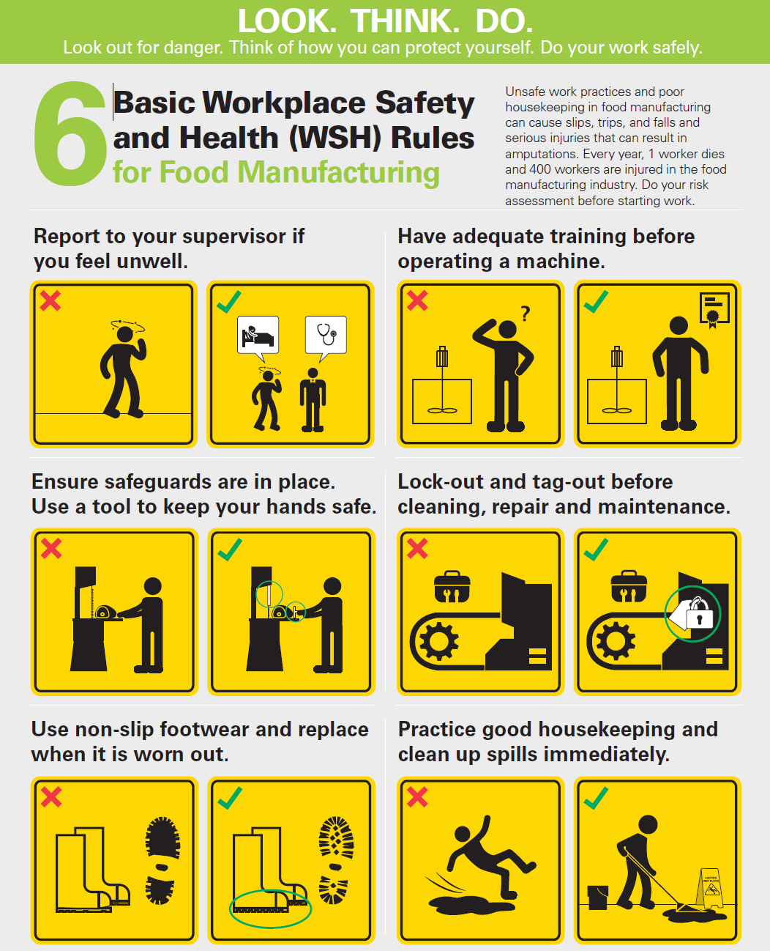
Risk Assessment
Notes:
Trainer notes:
Inform workers of this Look Think Do poster on basic WSH Rules for Food Manufacturing which include good safety pointers
Share with them on the following:
Report to Supervisor if workers are not well. This is especially so if workers are on medication which may affect their alertness if they are operating machinery
Ensure workers are trained before operating a machine, so that workers can abide by the standard operating procedures or the instruction manual as well as safety procedures
Inform workers to check for safeguards in place before operating machine. Ensure the guards are in working condition too.
Lock-out Tag-out (LOTO) is a procedure to ensure machine is safe before we do repair, maintenance (e.g., cleaning) and inspection. This is done by isolating hazardous energy sources to the machine.
Inform workers more details on LOTO will be covered in Caught in Machine hazards later
Slip, Trip and Fall (STF) is a top 3 hazards in recent years. Emphasise the need for non-slip footwear. Workers should check their footwear and replace it if it is worn out.
Good housekeeping to keep workplace clean of spills to prevent STF.

Slide 9
3.1 Addressing Risks
Step 1 Identify the Hazards.
- Types (e.g., machinery hazards) and the associated risks.
Step 2 Evaluate the Risks.
- Is risk level acceptable? Low, medium and high.
Step 3 Implement Risk Control Measures.
- Take action to eliminate or reduce risks.
Notes:
Trainer Notes:
Identify, Evaluate and Control is actually similar to Look Think Do.
Share examples of other common workplace hazards (e.g., physical, chemical hazards present in your work environment).
Provide examples of how risk level (e.g., low, medium, high) is determined at your workplace.
Emphasise that risk control is important to prevent injuries. Give examples of action that can be taken to eliminate or reduce risks.

Slide 10

3.2 Risk Control Measures
Reduce the need for direct interaction with machine through the use of technology or automation.
Replace with a safer machine or manufacturing process.
Use of machine guards and interlock system.
Use of safe work procedures and
lock-out tag-out.
Use of hardhat, safety goggles, safety gloves, hearing protectors and safety footwear etc.
Notes:
Trainer Notes:
Share the hierarchy of risk control. Insert your own examples as appropriate.
Emphasise that elimination and substitution are most effective with PPE being the least effective in terms of risk control.

Slide 11
4. Communication of WSH Hazards
Supervisor to highlight site-specific/equipment-specific WSH hazards (e.g., during toolbox meetings).
Workers are encouraged to inform Supervisor of any unsafe situation encountered at their worksite.
Near-miss incidents should be reported so that actions can be taken to prevent accidents.
Ref: WSH Guide to Effective Toolbox meeting. Click guide.
Notes:
Trainer Notes:
Emphasise the importance of workplace communication and hazard awareness for workers, contractors, vendors and clients.
Encourage workers to share their personal experiences during toolbox meetings. Also encourage workers to report near-misses and emphasise how near miss reporting can lead to accident prevention.
Refer to WSH Guidelines on Near-miss Reporting available at www.wshc.sg.
Assure workers that near miss reporting is for the good of the organisation, and that a no-blame culture is in place to facilitate this.
Highlight the difference between unsafe act (e.g., not using the provided PPE) and unsafe condition (e.g. working with a machine not provided with a guard).

Slide 12
5. Common Hazards
5.1 Slips, trips and falls
5.2 Caught in machine
5.3 Struck by falling object
5.4 Contact with hot objects/surfaces
5.5 Musculoskeletal Disorder
5.6 Fires and explosions
Notes:
Trainer Notes:
Highlight the common hazards encountered at your workplace.
Feel free to add on or amend the list of hazards to meet your workplace needs.
Give examples or ask workers to contribute examples along as you elaborate on the different hazards.
Feel free to refer to WSH Council’s collaterals (e.g., posters, checklist and guidelines where relevant) available at www.wshc.sg in your sharing.

Slide 13

5.1 Slips, Trips and Falls
Slips, Trips and Falls are the most common causes of workplace injuries and can result in sprains, fractures, severe head injuries and even fatalities in some cases.
Do:
Practise good housekeeping.
Wear anti-slip shoes.
Report uneven/damaged flooring.
Put up warning signs:
  slippery floors
  uneven floor
  damaged floors
Insert picture of obstructed walkway or spills
Notes:
Trainer Notes:
Good Housekeeping
Emphasise good housekeeping practice to keep workplace free from clutter by removing obstructions along walkway.
Refer to WSH Guidelines on Workplace Housekeeping.
Share on the benefits of good housekeeping which address WSH hazards (e.g., Slip, Trip and Fall) as well as fire hazards (e.g., to facilitate emergency evacuation).
Inform workers to regularly check the condition of their footwear and to replace if it is worn out.
Do share with worker if there is a company policy to replace worn out safety footwear? Ensure workers adhere to this policy (if in place) for safety.
Hazards reporting
Workers to look out for STF hazards e.g. wet floor due to spills, broken or missing tiles leading to uneven ground, electrical cable stretched across a walkway.
Ensure there is a feedback channel or means to gather these suggestions and to act on them promptly.
Encourage workers to work with cleaners or maintenance staff on identified areas that need attention e.g. spill clean-up, condition of warning signs.

Slide 14
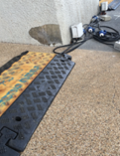
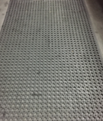
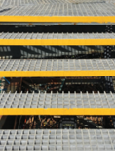

Slips, Trips and Falls
Some control measures include:
Cable trench to cover cables
Increase floor resistance e.g., placing anti-slip tape/mat/tiles
Cable trench
covering cables
Anti-slip mat
Warning strips
on steps
Anti-slip tile
Notes:
Trainer Notes:
Explain how various measures (e.g., cable trench, anti-slip tape etc) can be used to address STF hazards.
Use real-life examples at your workplace to illustrate the implementation of STF risk control measures

Slide 15
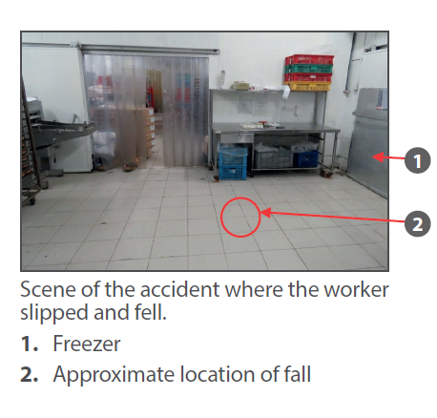
Slips, Trips and Falls
Case Study
A worker slipped, fell and hit her head on the floor at a bread factory around 1.30 am.
The slippery floor was caused by condensation outside the freezer. Worker was wearing her own footwear and walking towards the freezer when the accident happened.
The worker became unconscious and subsequently passed away.
Recommendations
Practise good housekeeping by keeping the floor dry.
Install signages to warn others of wet floor.
Wear safety footwear at all times and ensure that it is in good condition by checking it regularly.
Ref: Case Studies for Food Manufacturing (link).
Notes:
Trainer Notes:
Accidents are preventable if there are risk controls in place (e.g., provision of safety footwear, anti-slip mat/ signage to indicate wet floor)
Good housekeeping practice can help to keep floor dry and non-slippery (e.g., due to water or oil).
Ensure there is sufficient rest period for shift workers, so that they can remain alert and aware of hazards in the work environment.

Slide 16
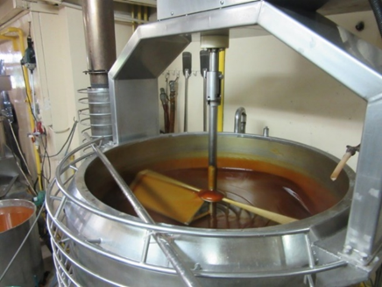
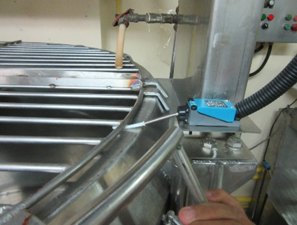
5.2 Caught in machine
Machines with moving parts, if not handled properly, can cause severe injuries.
Injuries may also occur when working with unguarded machinery.
Many machines pose mechanical hazards which may lead to cuts entanglement, crushing, etc.
Use of machine guard is an effective engineering risk control measure.
Mixer without guard
Interlock installed such that mixer
will shut off once the cover is lifted
Notes:
Trainer Notes:
Machines and tools with moving parts can pose amputation risk if workers are not careful. On average, there is one workplace amputation case in Singapore every 3 days. (Source: MOM WSH National Statistics Report 2017 & 2018)
Workers should not work with machines that are unguarded.
Check condition of guard (e.g., not damaged, properly secured)
Machine guards may be temporarily removed (e.g., for machine maintenance) only if the machine is de-energized and locked out.
Share some basic safety precautions that can be taken to prevent being caught in machine (e.g., long hair should be bun-up; no loose clothing or oversized gloves; no jewellery)
Refer to:
a) WSH Guidelines on Safe Use of Machinery
b) 6 Basic WSH Rules for Working with Machines
c) Activity Based Checklist on Working Safely with Machines

Slide 17

Caught in machine
Do:
Allow only trained, competent and authorised personnel to operate the machine.
Install warning sign(s) to alert machine operator the presence of hazard.
Ensure machine guarding is in place before operating the machine.
Turn off the main power switch before carrying out repair, maintenance and inspection.
Apply Lockout Tagout (LOTO ) procedure.
Notes:
Trainer Notes:
Machine hazards are common and workers need to be alert when working with machinery and power tools.
Rotary machines may give rise to nip/pinch points as well as draw-in hazards.
Warning signs should be placed prominently to alert workers of machine hazards
LOTO is an effective way to de-energise a machine before repair, maintenance or inspection is carried out.
Refer to WSH Guidelines on Safe Use of Machinery for more on LOTO

Slide 18
Caught in machine
LOTO procedure
Announce the shutdown
  Notify all affected workers that the machine is to be shut down.
Shutdown the machine
  Proceed to shut down machine after ensuring that all moving parts have come to complete stop.
  Ensure that there is no hazard caused to the workers during the shutting down of the machine.
Disconnect the energy source
  Ensure the hazardous energy to the machine is properly isolated using circuit breakers, valves or isolating switches.
  Confirm stored energy (e.g., present in springs, electrical, hydraulic and pneumatic systems) is dissipated before starting work.
Notes:
Trainer notes:
Share the 5 steps of LOTO procedure involved (source: WSH Guidelines on Safe Use of Machinery)
Do provide samples or pictures where available such as: lock-out device (e.g., padlock) or a typical tag for the tag-out
Emphasise the need of good communication to ensure the work (e.g., repair, maintenance, cleaning, inspection etc) is carried out safely

Slide 19
Caught in machine
LOTO procedure
Apply lockout tagout
  Use a padlock to ensure hazardous energy cannot be restored unexpectedly or accidentally.
  Affix a durable tag to provide identity of the person placing the lockout, and to warn that a work activity on the machine is in progress.
Verify the isolation and lockout
  Check isolation and lockout is in use and effective.
  Test the machine to confirm that it is unable to start by switching the controls to ‘on’ position.
  Switch back to ‘off’ after the test.

Slide 20

Caught in machine
Do not:
Work if you are unwell or on medication that can
affect your alertness at work.
Wear loose clothing or jewellery when operating
the machine.
Place your hands inside the machine while it
is in operation.
Notes:
Trainer Notes:
Workers operating machine should inform Supervisor if they do not feel well or they are on medication that may cause drowsiness. Supervisor may look for replacement or temporarily re-allocate workers to carry out admin work.
Ensure good fitting gloves/sleeves/overalls to prevent being caught in machine.
Remove all jewellery (e.g., ear-rings, rings, bangles, necklaces) before working with a machine. Use a hair net as necessary
Refer to the 6 basic WSH Rules for Food Manufacturing for a set of relevant Look Think Do pictograms
Never place one’s hands inside a machine when it is still in operation.
Share the recent hand injury (Mar 2019) involving meat grinder without guard at a local Supermarket. Workers should not work with the machine if guard is not provided or not in use.

Slide 21
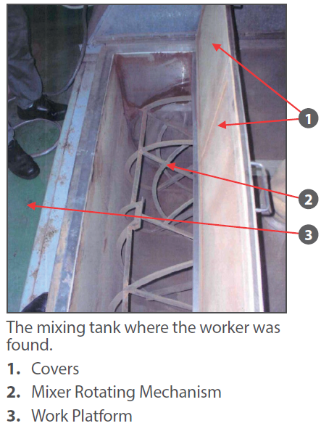
Caught in machine
Case Study
Worker was collecting a sample of blended food product from a mixing tank.
Mixing tank was still in operation when the worker opened its cover to collect the sample.
Co-worker found the injured worker inside the mixing tank and he was pronounced dead at the scene.
Recommendations
Install a safety interlock to power off the mixing tank once its cover is opened.
Collect the sample from the missing tank only if the mixer rotating mechanism has been de-energized.
Collect the sample from a safe location (e.g., from the storage container of blended product) instead of directly from the mixing tank.
Notes:
Trainer Notes:
Above accident can be prevented if there is proper risk control in place.
A safety interlock can help to monitor the position of a machine guard or cover. The interlock can be programmed to automatically shut off the power supply and stop the machine once the guard or cover is opened.
Other risk controls include relocating the sampling point to a safe location (e.g., from the bottom of tank) – this will eliminate the risk of contact with moving equipment parts

Slide 22
Cases in the news
Past cases where machine guarding could be used to prevent accidents:
1. Worker caught by mixer rotating arm while preparing bean paste.
URL: https://www.straitstimes.com/singapore/bakery-owner-died-when-he-was-caught-by-rotating-mixer-arm-and-pulled-inside
2. Worker’s arm caught in meat grinder in supermarket.
URL: https://www.straitstimes.com/singapore/giant-supermarket-worker-hurt-after-arm-caught-in-meat-grinder
Notes:
Trainer Notes:
Share the above cases involving a food mixer and meat grinder.
Advise workers to inspect/ check the machine guard before operating machine. They should not use the machine if guard is not present or damaged.

Slide 23
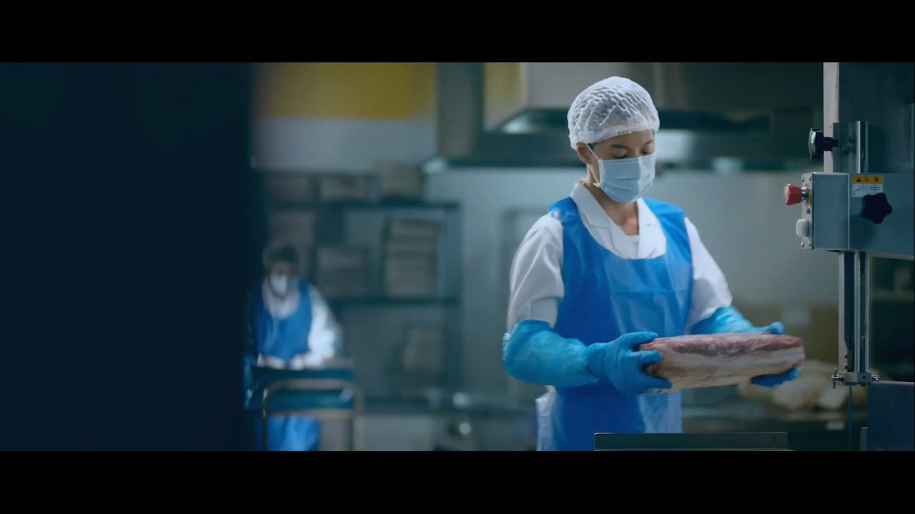

Caught in machine
All hand injuries are preventable!

Slide 24

5.3 Struck by falling object
Struck by falling object (SBFO) can lead to head or body injuries and even death. SBFO may occur in warehouses and store rooms with rack systems.

Slide 25

5.3 Struck by falling object
Do:
Store loose, small or irregularly shaped items in
boxes/crates.
Secure items from falling off with bars or straps across the shelf.
Store heavy items on lower shelves.
Use a step stool or ladder for access to foods above head level in a store room.
Adhere to the safe working load of the storage rack.
Inform Supervisor of unstable racks or loose/corroded joints encountered daily during periodic inspection.
Put a safety helmet in work areas where there is a risk of falling object.
Notes:
Trainer notes:
Observe safe work practice in warehouse or store room. This may include but not limited to: storage of goods to ensure rack stability (e.g., by placing heavy items on lower shelves, adhering to safe working load of the storage rack).
Highlight the importance of periodic inspection of the storage rack/ shelf. Emphasise what to inspect e.g., loose/ missing bolts, corroded/ dented rack, overloading of rack etc. Report all findings to Supervisor.
Workers also need to look out for material handling equipment (e.g., fork lift, reach truck) and the speed/ driving manner, which may cause workplace accidents, injuries as well as rack damage and subsequent rack instability.

Slide 26
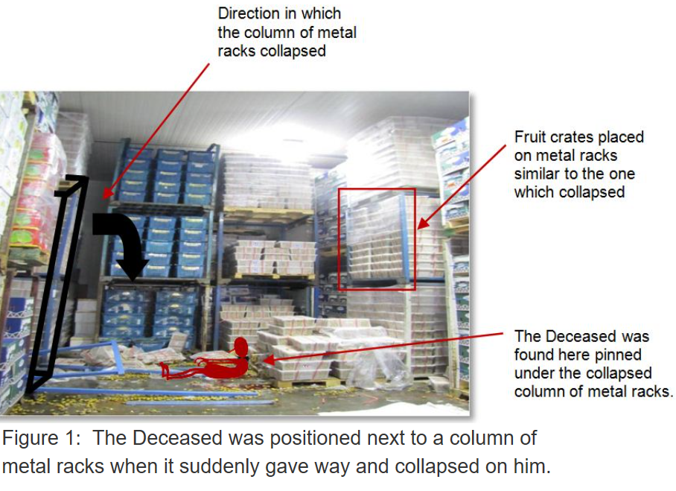
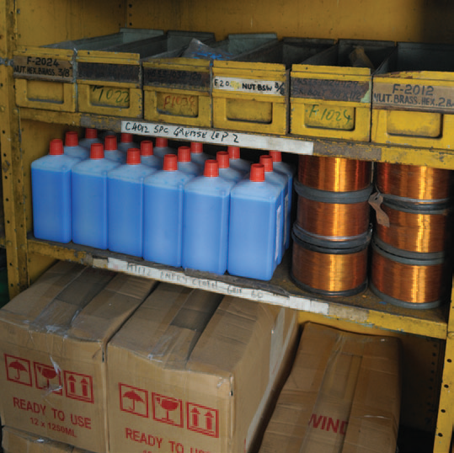
Struck by falling object
Case Study
A worker was found dead after he was pinned beneath the fruit crates in a warehouse.
He was standing next to a stacked column of metal racks which collapsed on him.
The racks were used to store crates of fruits.
Recommendations
Use engineered racks to store heavy items.
Store heavier items on lower racks
Ensure no over-loading of items on the rack.
Conduct periodic inspection to look for defects
in the racks (e.g., corrosion, dents and loose
bolts and nuts).
Heavier items placed
on lower racks
Notes:
Trainer Notes:
Emphasise the need to store heavier items on the lower shelves, as this will enhance the stability of the rack.
Inform workers to look for safe work loading (SWL) of each shelf and ensure no overloading.
Remind warehouse workers to be observant and report any rack/ shelf defects (e.g., damage, corrosion, or loose nuts etc) to Supervisor

Slide 27
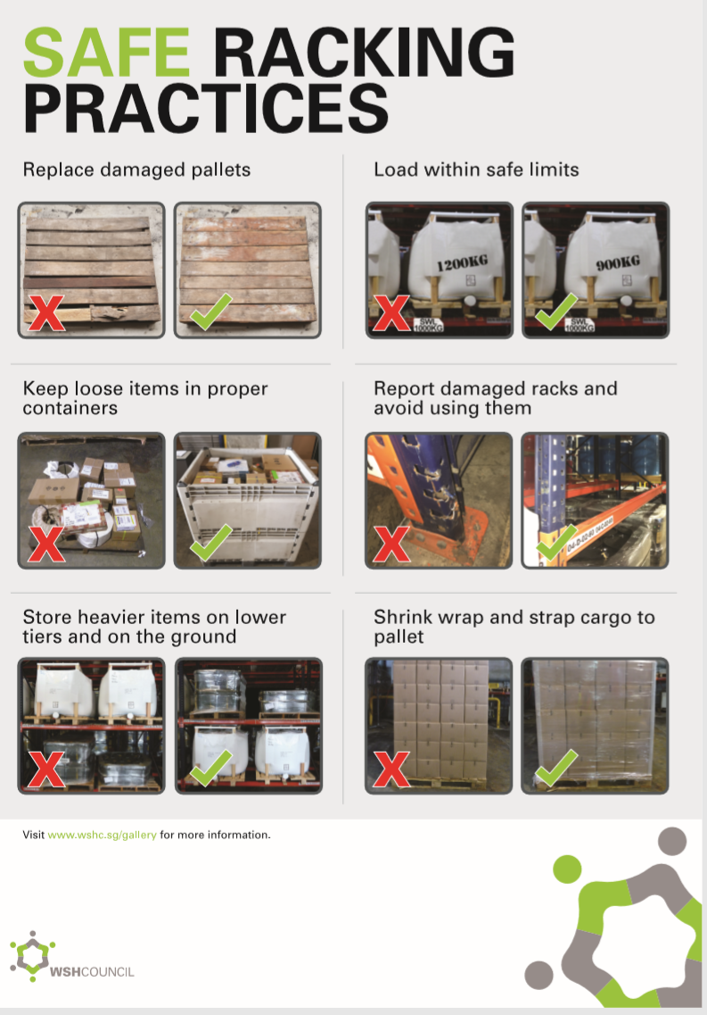
Struck by falling objects
Notes:
Trainer notes:
Inform workers this is a poster produced by WSHC on Safe Racking Practices
Emphasise the need to report damaged pallets and racks, and not to use them at all.
Ensure the loads within the safe limits of the racks.
Share other good racking practices e.g., storing of loose items in proper containers, heavier items on lower tiers and on the ground
Shrink wrap cargo before strapping them to pallet for better securement

Slide 28

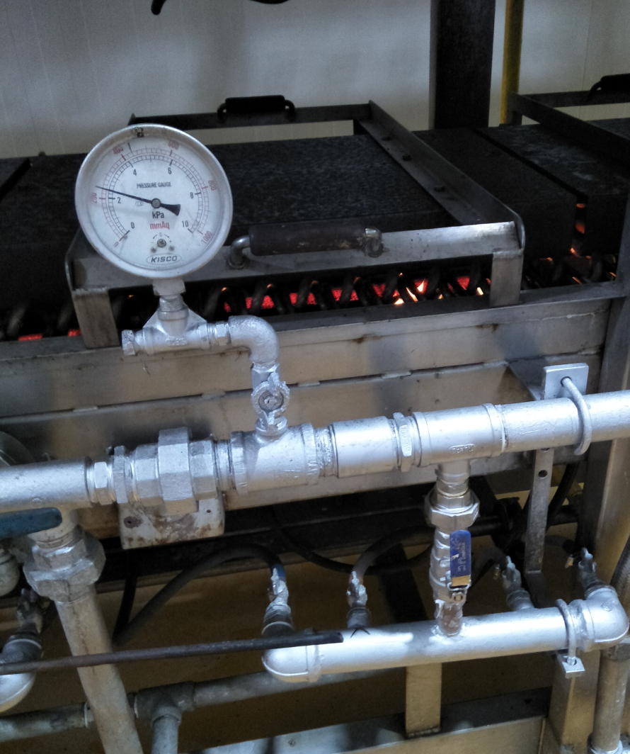

5.4 Contact with hot objects/surfaces
Contact with hot objects/surfaces may involve contact with hot machines or processing equipment (e.g., steamer, oven), hot medium (e.g., deep frying oil) and hot food intermediate/product. Serious injuries such as burns or scalds can take place, and even resulting in death.
Do:
Ensure all hot surfaces are insulated..
Check for presence for warning signage(s) on hot surfaces including gauges and sampling points where insulation is not present..
Wear appropriate PPEs ( e.g. gloves) when there is a need to work with hot equipment.
Hot surface where insulation not present
Photo credit: Thong Siek Food Industry
Notes:
Trainer Notes:
Highlight the hazards when dealing with heat either via contact with open flame/ liquid/ steam or with a hot object/ surface.
Ensure that risk controls (e.g., hot surface insulation, thermal gloves, overalls, warning signs) are in place to reduce the risks of burns and scalds.

Slide 29
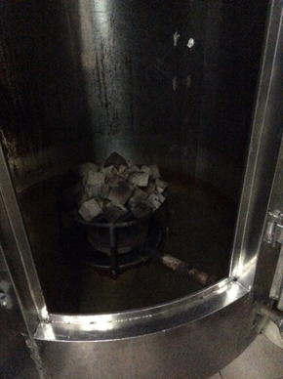
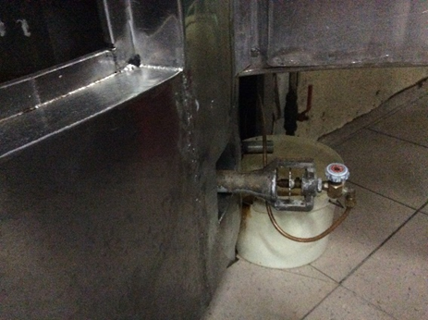
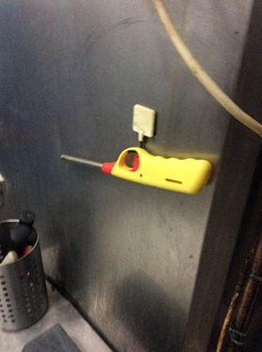
Contact with hot objects/surfaces
Case Study
A worker closed the door of an oven after placing meat into the oven for roasting. After 30 mins, he opened the oven door and turned the gas knob to release gas to the stove. He then lighted up the gas stove. Fire suddenly gushed out from the oven and injured the worker.
Fig 1: Gas stove
inside oven
Fig 2: Releasing knob for gas
Fig 3: Gas lighter
Notes:
Trainer Notes:
Above accident occurred in a meat factory that handles roasting of meat using gas ovens.
Such fires can be prevented if staff undergo proper training on safe gas stove/ oven operation and follow the safe work procedure for stove lighting.

Slide 30
Contact with hot objects/surfaces
Recommendations
Train the worker on the safe use of the stove and oven.
Provide a physical barrier or better position the gas knob so as to avoid the possibility of accidental contact with the gas knob.
Carry out periodic inspection of the oven, gas knob and piping as part of preventive maintenance regime.
Ensure there is adequate ventilation provided at the workplace.
Notes:
Trainer Notes:
Starting up a fire is simple but can be dangerous if safe work procedure/ sequence not followed
Worker should receive training on the safe work procedure for oven start up prior to using the industrial stove for the first time. Closely supervise the worker until he/ she is competent in the task.
Gas in the work area can be detected through smell or by a gas detector. Advise workers never to light the stove once gas is detected in the work area. Instead, ventilate the area as quickly as possible.
Soap solution may be used to check for possible leaks in gas piping
Adequate ventilation is to ensure there is no possible accumulation of flammable gas in the event of gas leaks.

Slide 31
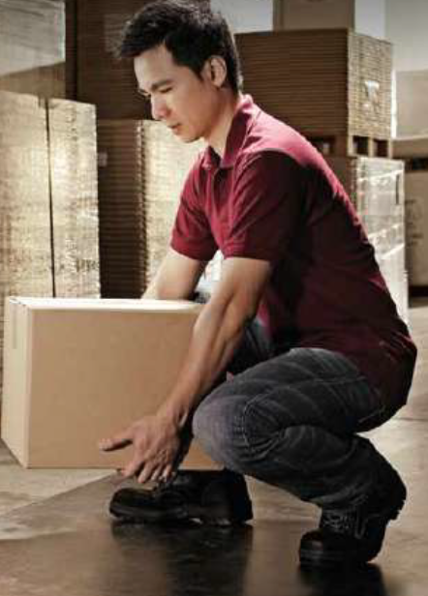
5.5 Musculoskeletal Disorder (MSD)
MSD refers to body disorders involving muscles, tendons and nerves. Symptoms of MSD include pain, cramp, swelling, numbness and tingling sensation. Examples of MSD include trigger finger, carpal tunnel syndrome, pain (neck, shoulder, lower back).
Do:
Bend your knees and keep your back straight when lifting an item.
Seek help or use a trolley when moving heavy items.
Use hand tools which are ergonomically designed (e.g., soft grip handle) to minimize excessive exertion.
Inform your Supervisor if you experience bodily
discomfort (e.g., aches, cramps) which could be
symptoms of ergonomic problems.
Notes:
Trainer Notes:
Work-related MSD is one of the top 3 Occupational Diseases listed in MOM WSH National Statistics Report 2017 & 2018
Refer to WSH Guidelines on Improving Ergonomics in the Workplace for more on the key elements of an Ergonomics Programme
Share the benefits of an Ergonomics Programme and encourage workers to participate in the activities (e.g., survey, hazard identification, workplace monitoring)
Seek help from co-worker or use a trolley for moving heavy items to minimize body exertion. Share pictures of tools (e.g., soft grip) to illustrate the use of minimal grasping force which can help eliminate pressure points on our hands.
Workers should take rest breaks and do simple stretching exercise if working in a particular posture for prolonged periods
Feedback to Supervisor if body discomfort is experienced so that the issue may be addressed as early as possible.

Slide 32
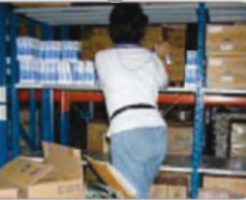
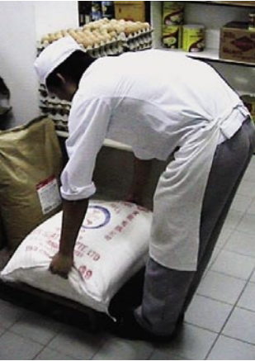
Musculoskeletal Disorder (MSD)
Do not:
Engage in prolonged repetitive activities without taking breaks.
Adopt awkward posture.
Adhere to static posture throughout
work.
Bend down when carrying a heavy item.
Subject yourself to prolonged vibrations.
Awkward posture of overstretching
Incorrect lifting of
heavy objects
Notes:
Trainer Notes:
Work involving repetitive movement (e.g., frequent loading of ingredients into mixing tank) may cause severe strain on our body.
Advise workers to adopt proper lifting posture when handling heavy items so as not to incur back injury.
Use a trolley or material handling equipment (e.g., pallet jack, reach truck, forklift etc) for handling heavy load.
Encourage workers to report to Supervisor if there are extreme hand-arm or whole body vibrations during equipment operation.

Slide 33
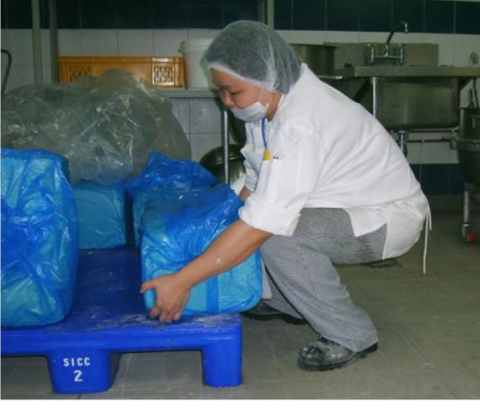
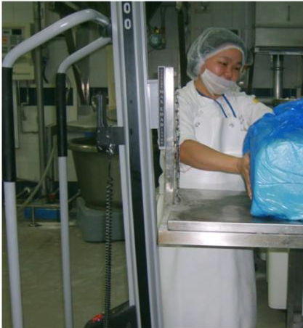
Musculoskeletal Disorder
Case Study
Worker is required to manually transfer 4 bags of dairy product every day. Each bag weighs 25kg.
Worker experiences severe strain on back, arms and legs, resulting in high absenteeism from work.
Recommendations
Eliminate the need for manual lifting where possible.
Use a mechanical aid to reduce the strain posed on the worker.
Seek help from co-worker or transfer smaller quantities (e.g., 10kg) per trip.
Worker lifting bags of dairy product
Worker using mechanical aid for the lifting
Notes:
Trainer Notes:
To ease the strain on the worker, the use of a mechanical aid (e.g. lifter) is recommended
Another suggestion would be to procure the dairy product in smaller bags (e.g. 10 kg per bag)
Place the dairy product as close as possible to its intended destination

Slide 34
5.6 Fires and explosions
Fires can occur in the presence of flammable materials, oxygen and an ignition source. Explosion can happen when the equipment or piping are over-pressurised. Fires and explosions can also occur when dealing with finely divided materials (e.g., flour, icing sugar).
Insert pictures of flammable materials

Slide 35
Fires and explosions
Do:
Keep area work free of ignition source or flammable materials wherever possible.
Ensure the workplace is well-ventilated when handling finely divided materials.
Periodically maintain the local exhaust ventilation system (e.g., canopy hood with associated ducting used for deep frying to ensure no accumulation of flammable materials (See recent fire at local hotel here).
Ensure proper electrical bonding/grounding when transferring materials from one tank/ container to another.
Ensure fire fighting equipment (e.g., extinguishers,hose reels), alarms and detectors are checked and tested periodically.
Notes:
Trainer Notes:
Share the 3 components required to start a fire: Fuel, Oxygen and Heat (Ignition). Remove any 1 of the 3 components to prevent or extinguish a fire.
Elaborate on the local exhaust ventilation (LEV) system at your workplace and its purpose.
Oil can accumulate within the LEV ducting over time. Regular maintenance and cleaning of LEV ducting is necessary to prevent fire outbreak within the ducting.
Share more on the recent fire at a hotel involving stove and exhaust ducting.
Static charges can be a potential ignition source if no proper bonding/ grounding was carried out before transferring materials from one container to another.
Illustrate with suitable diagrams examples of how proper bonding/ grounding can be achieved in your food manufacturing facility.
Fire extinguishers should be regularly checked for damage or tampering. Pressure gauge indicator should be in the green zone, pull-ring should be intact, seal not broken.

Slide 36
Fires and explosions
Case study: Dust Explosion involving Flour
A worker was cutting the support of an old conveyor pipe system with a cutting torch when flour poured out from the bottom opening of the silo.
Flash fire and dust explosion occurred when the flour came into contact with air.
Worker suffered burns on arms, face and other parts of body.
Recommendations
Establish a permit-to-work system for hot work activity so that the work area
can be assessed to be safe. In this case, the silo must be checked to be fully
drained before work commencement.
Ensure work area is well-ventilated when handling flammable dust.
Notes:
Trainer Notes:
Flammable dust (or other finely divided materials) can result in flash fire and dust explosion.
A permit-to-work system will help ensure that checks (e.g., via atmospheric testing) are carried out to ensure that the work environment is free from flammables before hot work is allowed to proceed.
To prepare for hot work, the silo and piping should first be purged of all content, water-washed and allowed to dry.

Slide 37
6. Other hazards
6.1 Cut by object
6.2 Fall from height
6.3 Exposure to electrical current
6.4 Noise-induced deafness
6.5 Fatigue
6.6 Exposure to chemicals
Notes:
Trainer Notes:
You may wish to insert other hazards commonly found at your workplace.
Include relevant case studies if available.
3. All hazards should be addressed in the Risk Assessment for the specific work activity.

Slide 38
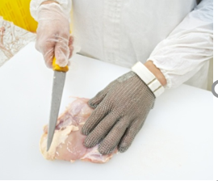

6.1 Cut by object
When preparing raw food for processing, hand injuries may occur if working with sharp tools (e.g., knives) or machines (e.g., band saw).
Do:
Use designated tool and ensure that it is sharp
before use.
Work on flat surfaces to ensure stability when
cutting.
Wear cut-resistant gloves when working with a
sharp tool.
Segregate sharp tools from other tools.
Return tools to designated place after use.
Use of sharp tools
Notes:
Trainer Notes:
Obtain instructions on proper use, storage and maintenance of equipment and tools from their respective manufacturer.
Allow only trained staff to operate sharp tools and equipment.
Maintenance of powered equipment and tools include cleaning and lubrication of mechanical parts.
Report to Supervisor if damaged equipment or tools are found.
5. Refer to www.wshc.sg for:
a) Activity Based Checklist for Working Safely with Non-powered Hand Tools
b) Activity Based Checklist for Handling Sharp Objects Safely
c) Risk Assessment and Control Measures (Food and Beverage) Checklist

Slide 39

Cut by object
Do:
Wrap all waste containing sharp objects before
disposing.
Use push plate when cutting meat with a band saw.
Use of push plate

Slide 40
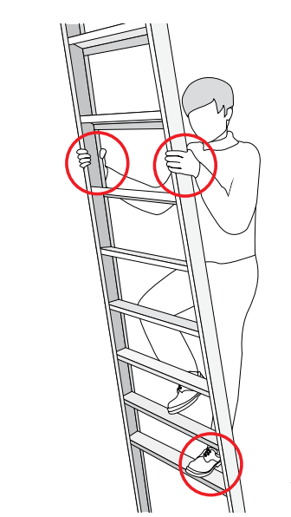
6.2 Fall from heights
Fall from height accidents in the food manufacturing sector often involve the improper use of ladders.
Do:
Use a ladder of the correct height for the job.
Maintain 3 points of contact with the ladder
at all times while ascending or descending.
Use anti-slip footwear.
Notes:
Trainer Notes:
Advise workers to check the condition of the ladder before using.
Emphasise the importance of 3-pt contact when using a ladder (see diagram with 3 red circles).

Slide 41
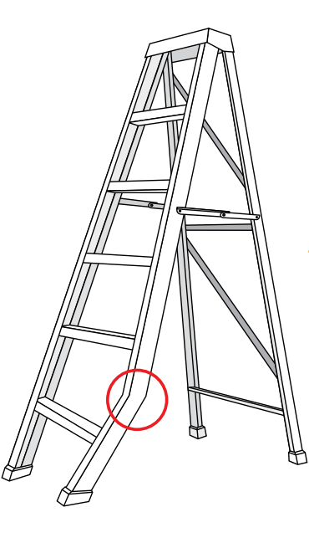
Fall from heights
Do not:
Carry loose items in your hands when using
a ladder.
Use the ladder on uneven ground.
Use the ladder if there is visible defect
(e.g., missing step, leg broken or bent).
Notes:
Trainer Notes:
Keep loose items (e.g., hand tools) in a pouch attached to waist belt so that one’s hands can be kept free to achieve 3-point contact.
Never work on the top rung of an A-frame ladder
Where possible, choose a step platform instead of an A-frame ladder
Refer to Code of Practice for Working Safely at Heights and Ladder Safety Guidebook for more information on safe use of ladders.

Slide 42

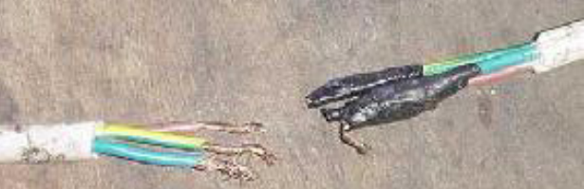
6.3 Exposed to electric current
There is a risk of electrocution when working with electrical equipment. Some pointers to note include:
Do:
Switch off electrical equipment when not
in use.
Isolate and replace damaged equipment.
Report any damaged wiring found.
Keep electrical equipment away from moisture or steam.
Unsafe act to use re-joined wires
Notes:
Trainer Notes:
Provide workers with the necessary training to safely operate electrical equipment
Hands must be kept dry when dealing with electrical equipment and power switches
Store/ position electrical cords/ cables in areas where there is low risk of incurring damage to its insulation
Workers should be alert to smoke or unusual smell coming from electrical equipment.
Share any incidents in your workplace that led to an electrical fire.
Refer to Factsheet on Working Safely with Electrical Equipment available at www.wshc.sg

Slide 43
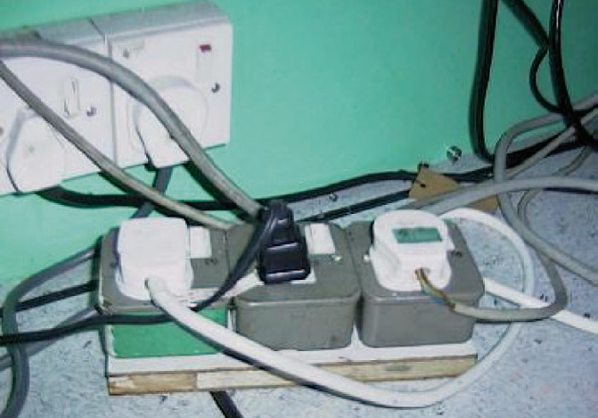
Exposed to electrical current
Do not:
Overload an electrical point.
Use damaged electrical equipment.
Repair damaged equipment if not qualified to do so.
Overloaded electrical point
Notes:
Trainer Notes:
Provide workers with the necessary training to safely operate electrical equipment
Hands must be kept dry when dealing with electrical equipment and power switches
Store/ position electrical cords/ cables in areas where there is low risk of incurring damage to its insulation
Workers should be alert to smoke or unusual smell coming from electrical equipment.
Share any incidents in your workplace that led to an electrical fire.
Refer to Factsheet on Working Safely with Electrical Equipment available at www.wshc.sg

Slide 44


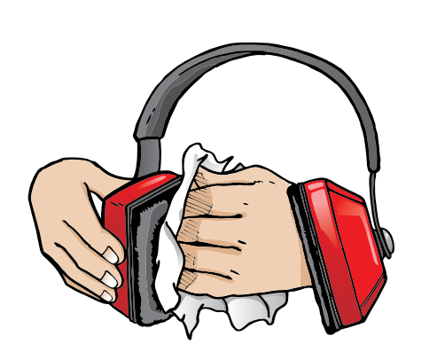
6.4 Noise-induced deafness
Frequent and long term exposure to loud sounds during work can cause noise induced deafness (hearing loss).
Do:
Wear ear plugs/muffs properly.
Practise job rotation for work in noisy areas.
Maintain your hearing protectors.
Take rest breaks in quiet place.
Do not:
Work in a noisy environment without hearing protection.
Use hearing protectors that are damaged or in poor condition.
Notes:
Trainer Notes:
Workers working in a noisy environment need to be aware that they are at risk of incurring noise-induced deafness.
Such workers should go for an annual audiometric examination (to detect for hearing impairment) as part of a Hearing Conservation Programme.
Workers should use adequate hearing protection when working in a noisy environment.
Taking breaks away from the noisy environment will help to lower a worker’s daily exposure to noise/ loud sounds.
Workers should inform Supervisor if they experience difficulty in hearing.
Refer to WSH Guidelines for Hearing Conservation Programme.

Slide 45
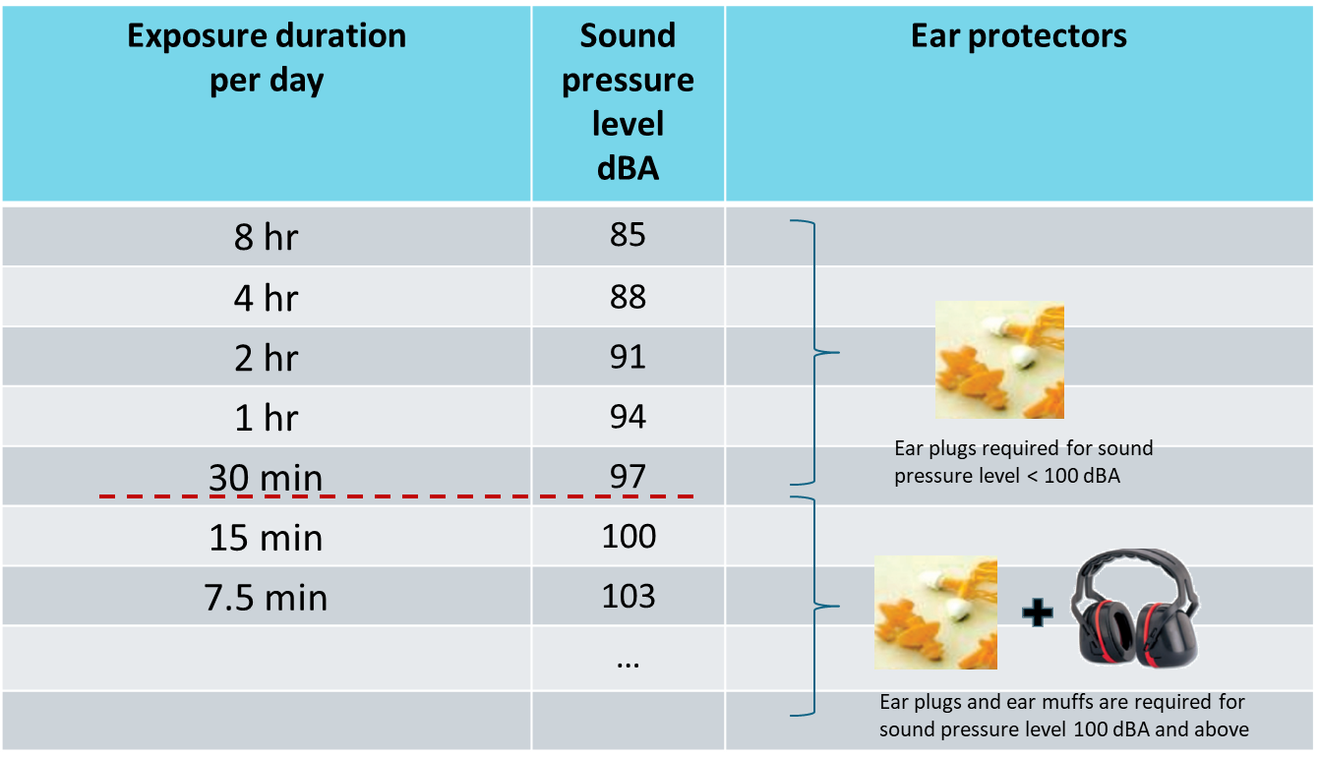
Noise-induced deafness
Notes:
Trainer Notes:
As the sound pressure level increases, the exposure duration per day should decrease. This is one way to protect our hearing ability.
For sound pressure level > 100 dBA, the use of both ear plugs AND ear muffs is recommended for better noise reduction.
Refer to:
WSH (Noise) Regulations 2011
WSH Guidelines for Hearing Conservation Programme

Slide 46
6.5 Fatigue
Fatigue is a state of tiredness leading to reduced mental and/or physical performance that can endanger workplace safety. It can decrease a person’s alertness and compromise a worker’s motor skills, reflex ability, judgement and decision-making while at work.
Do:
Ensure sufficient sleep before reporting for work.
Take rest breaks after working for long hours or carrying our strenuous work.
Ensure workplace is brightly lit and well-ventilated.
Report to your supervisor if you are severely fatigued.
Do not:
Consume excessive alcohol or over-eat before work.
Continuously skip meals due to work commitments.
Notes:
Trainer Notes:
Once fatigue sets in, concentration levels may drop and this can pose severe hazard to the worker/ co-workers, especially for workers working as vehicle drivers or equipment operators.
Highlight the possibility of microsleep (typically involuntary and lasting for a few seconds) which can endanger one’s safety especially when driving or operating an equipment.
It is important that shift workers working the night shift get sufficient sleep during the day before starting their shift.
Workers to inform Supervisor if they experience severe fatigue and are not fit to work.
Refer to WSH Guidelines on Fatigue Management.

Slide 47
6.6 Exposure to chemicals
Workers who are in regular contact with chemicals may experience skin sensitisation and/or respiratory problems.
Do:
Read the label on the chemical container to understand the nature of its contents and how it can be handled safely.
Check that the chemical container is in good condition.
Close containers tightly and return to designated place after use.
Ensure there is proper ventilation in the work area when using chemicals.
Use the appropriate PPE (e,g, face shield, gloves apron) to protect against chemical contact.
Notes:
Trainer Notes:
3 basic routes for chemicals to enter our body – Inhalation (nose), Ingestion (mouth) and skin/ eye contact.
Personal protection equipment (PPE), for example, respirator, safety goggles, chemical resistant aprons and gloves, may be used to limit/ prevent exposure during chemicals handling.
Workers should be given training on GHS labelling and how to read/ understand a Safety Data Sheet (SDS). In particular, the workers must be able to understand and implement the safety recommendations/ precautions stated on the SDS.
Workers should not work with the chemical if there is no label on its container.
Chemical storage areas should be adequately ventilated.
6. Refer to Activity-Based Checklist for Safe Storage of Chemicals available at www.wshc.sg.

Slide 48
Exposure to chemicals
Do not:
Use chemicals without knowing its nature.
Store incompatible chemicals together.
Try to contain a chemical spill unless equipped with a proper spill kit.
Notes:
Trainer Notes:
Workers need to know the nature of the chemicals before using them (e.g., chemicals may be corrosive, toxic, flammable, highly reactive).
Incompatible chemicals, if stored together, may result in accidental mixing (e.g., due to a leak or spill) and hazardous reactions/ by-products.
Workers may attempt clean-up for minor spills if they have received training on the emergency response procedure and the use of the chemical spill kit.
Refer to WSH Guidelines for Laboratories Handling Chemicals

Slide 49
END

