Slide 1
Accident Prevention through
Near Miss Reporting
All rights reserved, Feb 2021. The information provided in this training slides is accurate at time of publication. All examples shared in this training slides are meant for learning purposes only. The learning points for each example are not exhaustive and should not be taken to encapsulate all the responsibilities and obligations of the user of this training slides under the law. The Workplace Safety and Health Council does not accept any liability or responsibility for any modifications made to this set of training slides.
WSH Training Slides
(with Marine Industries Examples)
Notes:
Workshop/ Training Slides for Workers (with Notes for Trainers)
This set of slides may be used to complement your company’s in-house WSH training for workers.
Estimated Time for this Workshop = 75 to 90 mins

Slide 2

What is a Near Miss?
An incident where no injury and ill health occurs, but has the potential to do so – may also referred to as ‘near hit’ or ‘close call’.
Source: SS ISO45001:2018
Notes:
Notes for the Trainer:
Above definition of “near miss” extracted from SS ISO 45001: 2018 Occupational health and safety management systems – Requirements with guidance for use.
Potential = an incident/ event that could have resulted in a workplace accident. Accident = with injury or fatality.
Objective of NM Reporting is to prevent accidents and therefore leading to fewer workplace injuries and fatalities (in line with Vision Zero).

Slide 3
Activity 1: Near Miss vs Accident
Explain the difference between:
Unsafe Condition
Unsafe Act
Near Miss
Accident
[Allocated time: 10 mins discussion + 10 min presentation]
Notes:
Notes for the Trainer:
Divide your class into groups of 4 to 5 pax
Activity Objective: Understand the difference between Unsafe Condition, Unsafe Act, Near Miss and Accident
Ask your class to search online for images pertaining to “Near Miss vs Accident” and discuss the difference (10 mins)
Invite 2-3 groups to show their selected image and present their explanation (10 mins)

Slide 4
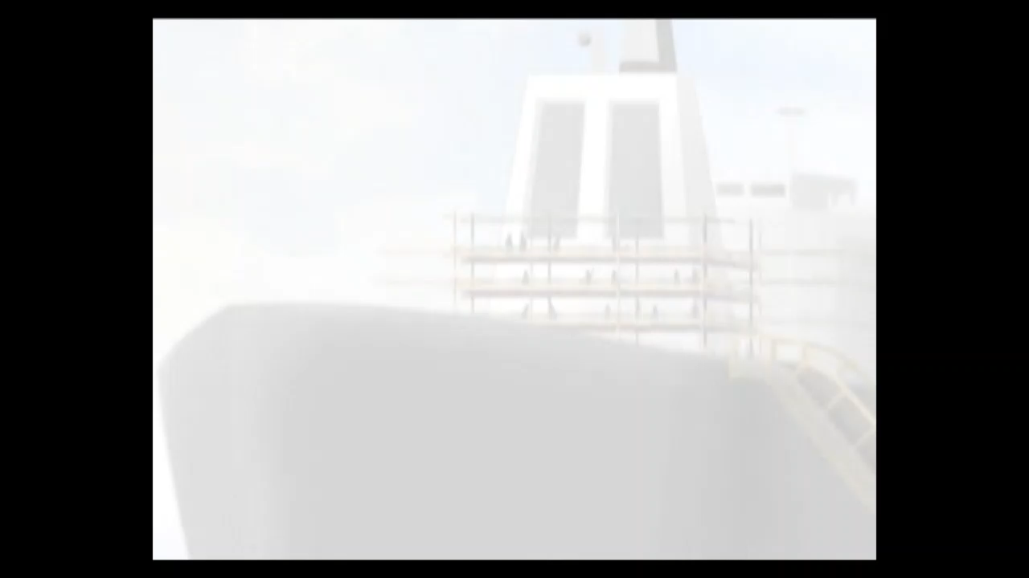
Video – Shipyard Safety Animation
Source: YouTube - Shipyard Safety Animation by WSH Council
Notes:
Notes for the Trainer:
This snippet of a video shows a near miss arising from an unsafe act. To recap again, a near miss is an unplanned event that did not result in any injury, illness or damage, but had the potential to do so.
Near misses featured in this video is:
Potential struck by object - scaffold pipes
Trainer can prompt qns: What if the workers did not report the near-miss? Rather than waiting for another accident to happen, workers should report the near-miss and the company should take pre-emptive action by tracking near misses.

Slide 5
Why Track Near Misses?
Major Injury
Minor Injury
Near Miss Incident
First Aid Case
Fatal
Accidents
Proactive way to prevent accidents
Modified injury pyramid based on
Heinrich’s Accident Triangle
Notes:
Notes for the Trainer:
Why track near misses?
Because it can significantly contribute towards accident/ injury prevention

Slide 6
“Companies should report near misses to bring down industrial accident rate.”
Minister of State for Manpower and National Development, Zaqy Mohamad
during launch of Safe Hands Campaign 2019 (Source: Straits Times)
Notes:
Notes for the Trainer:
Highlight the Government’s drive to encourage near miss reporting as a way to reduce workplace accidents.
Preventing accidents is a 360º effort involving company management as well as all workers.
NM reporting can help to foster a strong WSH culture. Make it a part of the work culture in your organisation.

Slide 7
Boost to WSH journey
WSH culture building
Leading indicator
Why Track
Near Misses?
Worker engagement
Zero-cost lesson
Protect workers from harm
Uncover and arrest hazards
Notes:
Notes for the Trainer:
Elaborate on the various benefits of NM reporting, for example:
It serves as a zero cost (read: free) lesson on accidents that can occur and steps that must be taken now to prevent future accidents
It is a leading indicator for WSH performance. May be used together with lagging indicators (e.g. injury rates) to ascertain a company’s holistic WSH performance.
It helps to build a positive & proactive WSH culture through direct worker engagement and ownership
A review of NM reports (e.g. monthly) may reveal situations or trends that, once addressed, contribute to accident prevention.

Slide 8

Include in company policy
Simple process
Offer incentives
Employee training
Encouraging
NM Reporting
Open sharing
Employee empowerment
No blame culture
Close every report
Care. Trust. Prevention.
Notes:
Notes for the Trainer:
For NM reporting to take off, process for reporting must be simple. Top mgt support must be clearly expressed in the company policy.
Some companies offer incentives (e.g. lunch voucher) for each NM report that results in implemented WSH improvement(s)
Every NM report should be followed-up and closed – this is to indicate that all NM reports are taken seriously.
A blame-free environment helps to encourage NM reporting by putting the focus on the WSH concern and not the worker(s).
NM reporting is worker empowerment – workers know their work areas best and each worker is given a say on WSH concerns.

Slide 9

Question
Should companies set a quota for NM reports?
Notes:
Notes for the Trainer:
Pose the above question to your class.
Invite them to discuss in pairs.
Provide 1-2 mins for them to discuss and come to a conclusion.
Sample at least 3 pairs to share their conclusion with the class (3 mins)
Suggested answer:
The answer is “NO”.
NM Reporting is not a numbers game
1 good report is better than 100 non-genuine reports
Each good report can help to prevent an accident
Quality is more important than quantity

Slide 10
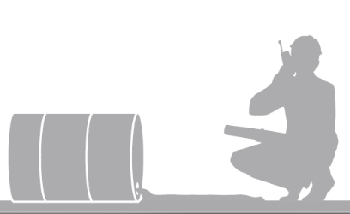
NM Reporting: Key Components
2 steps
Identify: Recognise the incident as a near miss
Report: Report to supervisor, WSH Officer or WSH Committee.
Investigate: Find out what happened & identify the problem
Intervene: Solve the problem
Review: Monitor & evaluate WSH performance
For management follow-up
Notes:
Notes for the Trainer:
There are 5 steps in a NM reporting system. For workers, only 2 steps apply - identify & report.
The remaining 3 steps are for mgt follow-up. Mgt follow-up is critical in order for a NM reporting system to be effective.

Slide 11
Step 1 – Identify
Recognise the NM incident
You will improve with practice
Refer to past reports for examples
It is OK to work in teams and discuss with your colleagues
Notes:
Notes for the Trainer:
To identify a near miss, workers must first recognise the incident as a near miss.
This may seem difficult in the beginning but assure your class they will improve with some practice
Referring to past NM reports for examples will also jumpstart your learning process
Practicing with an experienced colleague is a good start

Slide 12
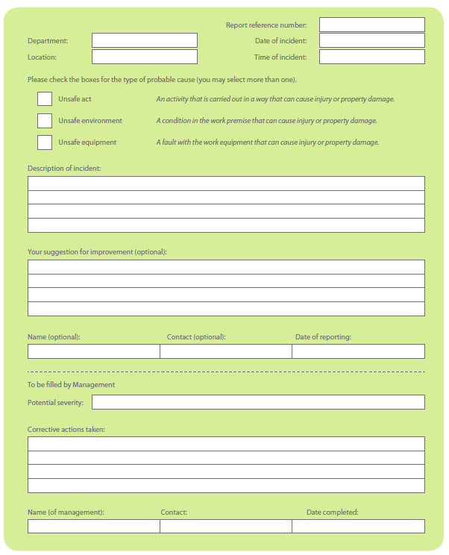
Step 2 – Report
Reporting is easy
Simply fill up a form!
Template
Key entries:
Incident Date, Time, Location
Probable Cause of Incident:
  Unsafe Act
  Unsafe Environment
  Unsafe Equipment
Description of Incident
Suggestion for Improvement (Optional)
Name & Contact of person reporting (Optional)
Date of reporting
Notes:
Notes for the Trainer:
The form can be in hardcopy or electronic (e.g. available on the company intranet or via a mobile app)
Run through the key entries of the form
The incident should be described as clearly as possible. Attach a photo wherever possible.
Suggestion for improvement is encouraged but optional. Name & contact of person reporting is also optional.
Bottom part of the form is for mgt follow-up

Slide 13
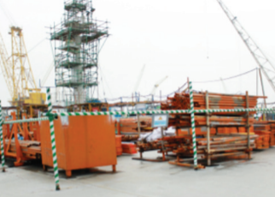

Example 1
Two workers were doing housekeeping and were sorting out pipes to place at the storage rack.
One worker decided to continue with the sorting on his own after his co-worker went away.
While rearranging one of the pipes on the rack, another pipe shifted. The worker immediately pulled his hands away to avoid them being caught in between pipes.
The worker filed a near miss report.
How would you improve this situation?
THINK
Notes:
Notes for the Trainer:
Quiz the class for suggestions on what they would do to improve the situation (2 mins).
Possible ideas include:
All persons involved in the work must be adequately trained to be competent in their jobs, as well as aware of the risks and safety precautions required of them.
When assigned to work in pair, do not carry out works alone.
Do not stack the pipes too high

Slide 14
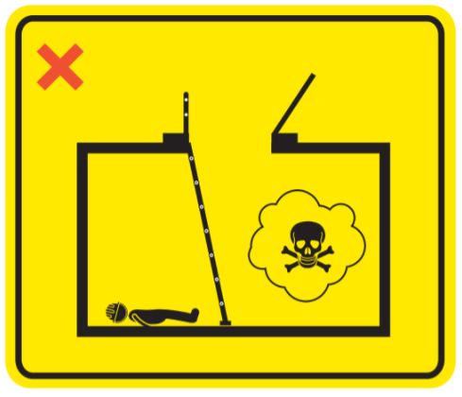

Example 2
A worker wanted to enter the ballast tank to do painting work. He did not have the Permit-to-Work (PTW) in the confined space.
He was about to enter the confined space when his co-worker stopped him.
The workers filed a near miss report.
How would you improve this situation?
THINK
Notes:
Notes for the Trainer:
Quiz the class for suggestions on what they would do to improve the situation (2 mins).
Possible ideas include:
• Not open up any manhole of confined spaces without proper authorisation.
• Not enter any confined space if they have not been trained for it.
Safety requirements for work in confined spaces. These include:
• A Permit-To-Work system for confined space entry is in place.
• The confined space has been sufficiently ventilated and tested safe by a confined space
safety assessor who has undergone the WSQ Assess Confined Space for Safe Entry
and Work course.
• Workers entering the confined space have undergone the WSQ Perform Work in
Confined Space Operation course.
• At least one of the workers inside the confined space is equipped with a portable gas
monitor to continuously monitor the level of oxygen or other harmful gases inside
the confined space.
• A confined space attendant is stationed outside the confined space.
• An emergency response and rescue plan is in place.

Slide 15
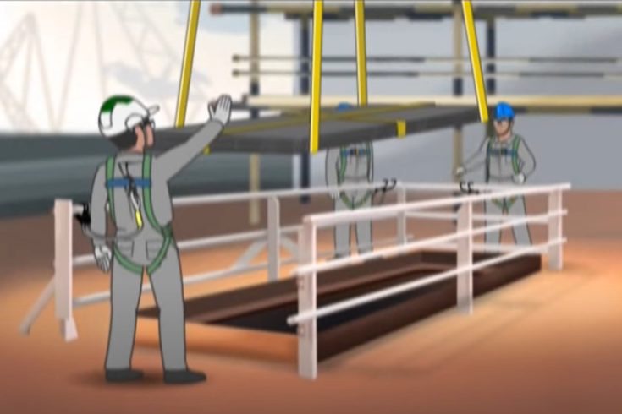
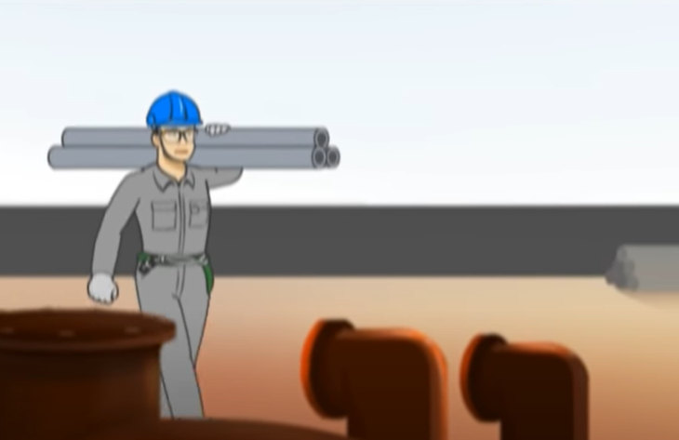
Example 3
A worker assisted the lowering of materials into an opening without barricade on one side. After completion of work, the barricade was not replaced.
Another worker was walking towards the opening and was stopped by the safety supervisor.
The safety supervisor reminded the first worker to place the barricade back to prevent falls and they filed a near miss report.
How would you improve this situation?
THINK
Notes:
Notes for the Trainer:
Quiz the class for suggestions on what they would do to improve the situation (2 mins).
Possible ideas include:
Follow safe work procedures
A barrier should be erected around the opening to prevent persons from falling.
Do not remove the barricade.
Be alert and look out of hazards in your work environment.
Allow only authorized personnel in the specified areas.

Slide 16
Activity 2: NM Reporting Hands On
In groups, identify a NM incident you have encountered in your work area and practice filing a NM report.
[Allocated time: 10 mins discussion + 10 min sharing]
Notes:
Notes for the Trainer:
Divide your class into groups of 4 to 5 pax
Handout hardcopies of the NM Reporting form OR ask the groups to write their Incident Description on a flipchart
Activity Objective: Practice filing a NM report
Brainstorming and group discussion (10 mins)
Invite 2-3 groups to share the NM incident they would like to report (10 mins)

Slide 17

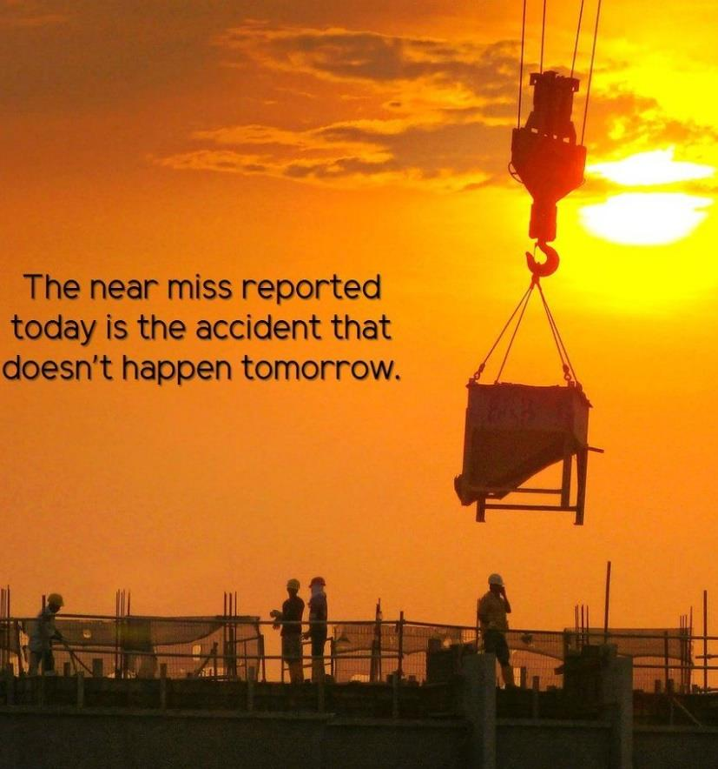
Concluding Thoughts
“Every near miss is a potential fatality; every near miss is a potential accident.”
Mr Tan Chuan-Jin
Then Minister for Manpower
at launch of National WSH Campaign 2015
Notes:
Notes for the Trainer:
We can all do our part by reporting near misses.

Slide 18

Thank you
Download: www.wshc.sg

